Slide 1
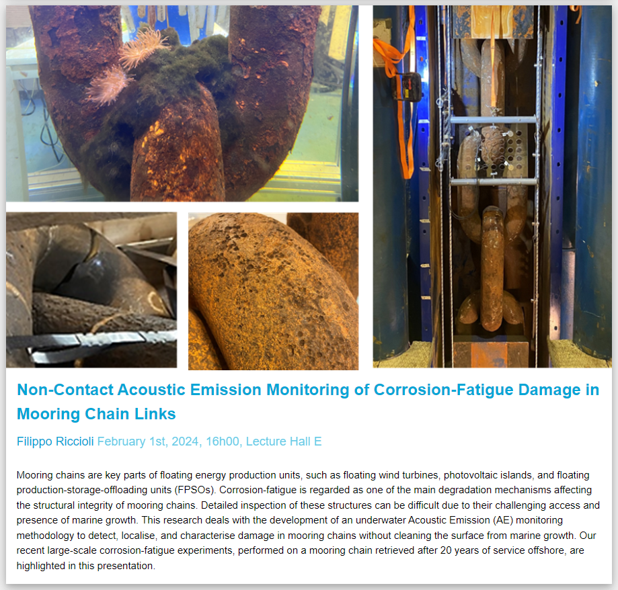
Picture: 10cm*16.18cm
Title
Presenter, Date, Room
Abstract

Slide 2

2024_WIP
Picture
AAA
aaa

Slide 3
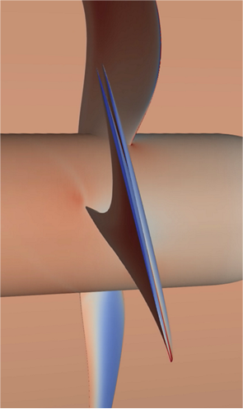
20240307_Laurens_Jan_v2

Slide 4
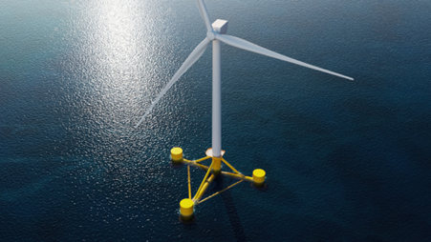
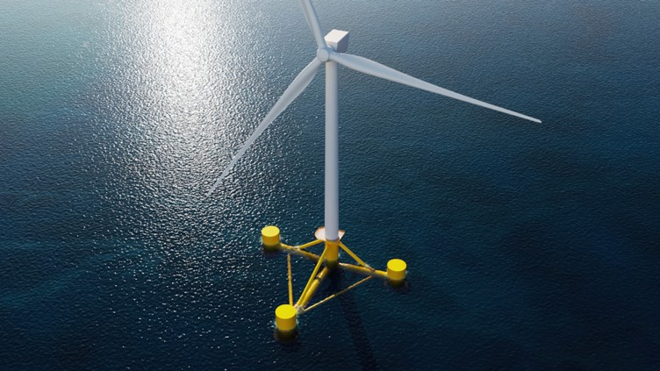
20240307_Kasia_v2

Slide 5
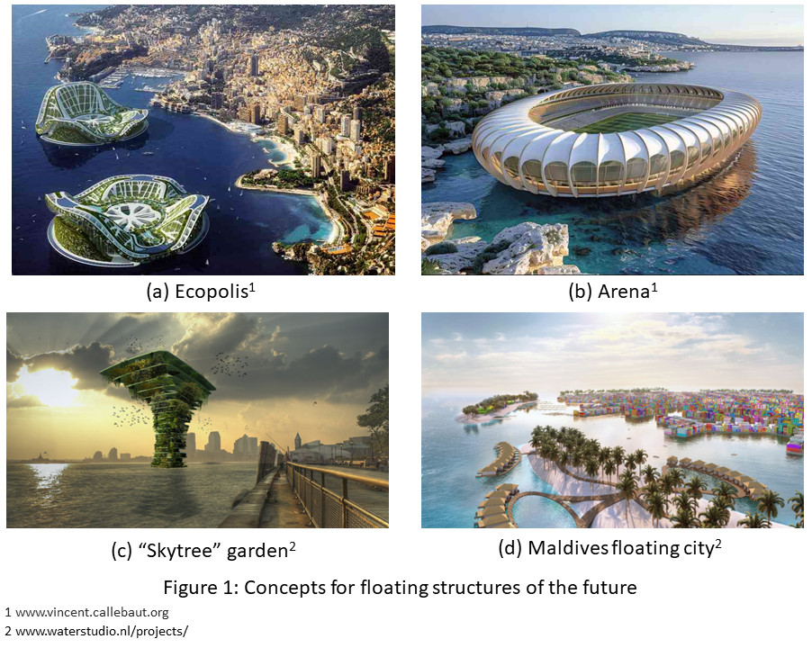
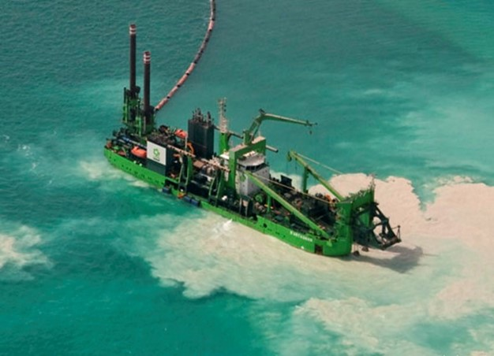
20240321_Christof
20240321_Mosaab
Engineering the skyline of tomorrow, at sea: Efficient analysis of large, nonlinear floating structures in the frequency-domain - Christof van Zijl
Sediment Plumes Generated by Cutter Suction Dredgers
Mosaab Mahgoub
Recent estimates project that by 2050, about 70 percent of the world’s population will reside in urban environments. With many major cities situated along coastlines, large-scale floating structures offer a promising solution to the challenges of rapid urbanization coupled with the effects of climate change.
The branch of engineering that deals with predicting the responses of flexible structures as they interact with the ocean is called hydroelasticity. The state-of-the-art methods in hydroelasticity involve simulating structural responses to fluid loading in the time-domain by exchanging information between the two domains at successive time-steps. However, this approach can be very time-consuming, which is unsuitable for design optimization and studying long-term structural responses under varying environmental conditions.
As an alternative, very efficient calculations can be performed in the frequency-domain. However, the sheer size of large floating structures, along with the seemingly conflicting demand for lighter constructions, results in highly flexible marine structures that exhibit nonlinear behaviour. Since frequency-domain analysis is generally restricted to linear structures, an alternating frequency-time domain algorithm is investigated to study nonlinear structural behaviour. The method is demonstrated for a simple, nonlinear system, and the application to coupled fluid-structure problems, including some challenges, is discussed.
Dredging-induced sediment plumes can cause severe damage to the aquatic environment: turbidity-related light reduction, smothering of sensitive habitats, and contaminant transport in case of environmental dredging. Cutter suction dredger (CSD) is the second main vessel utilized in the dredging industry. The main component of CSD is the cutter head, the role of the cutter head is to disintegrate (cut) the soil from the bed of the waterbody and mix it with water and then the soil-water mixture is transported as a slurry. The dynamic actions of the cutter head is the main trigger of sediment plumes generated during the operation of CSD. The near-field environment of the cutter head is very complex and sediment is released with different mechanisms. However, the common procedure followed in the dredging industry to quantify the sediment release rate (source-term) by CSD for the Environmental Impact Assessment (EIA) purposes is very simple and does not reflect the cutter head near-field dynamics, which causes a lot of uncertainties. Accurate prediction of the CSD source-term is essential for a trustable EIA and requires a full understanding of the cutter head near-field environment, which is still not achieved. My PhD research is to investigate the cutter head near-field environment and analyze its related sediment resuspension mechanisms for the objective of developing better source-term estimation model for CSD. My research methodology includes both numerical and experimental modelling.

Slide 6
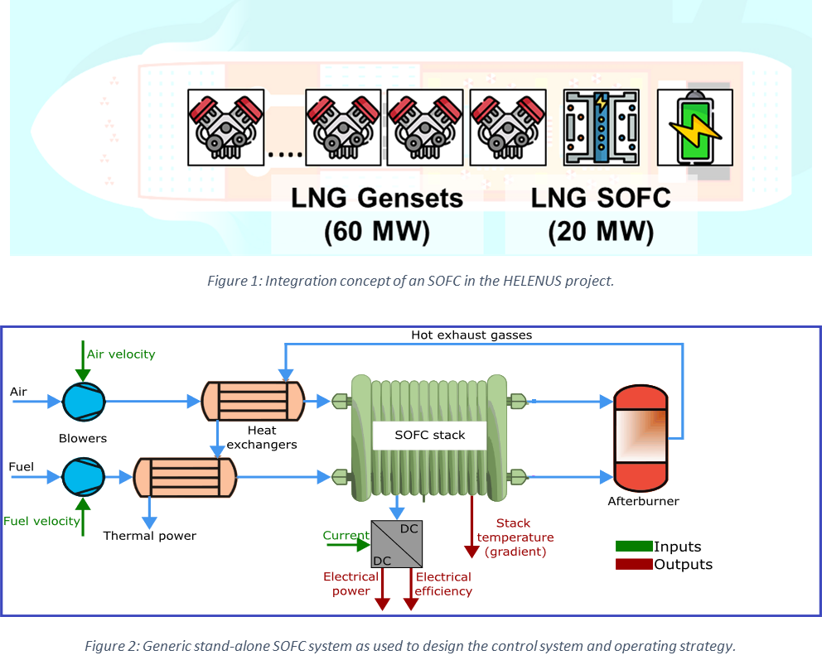
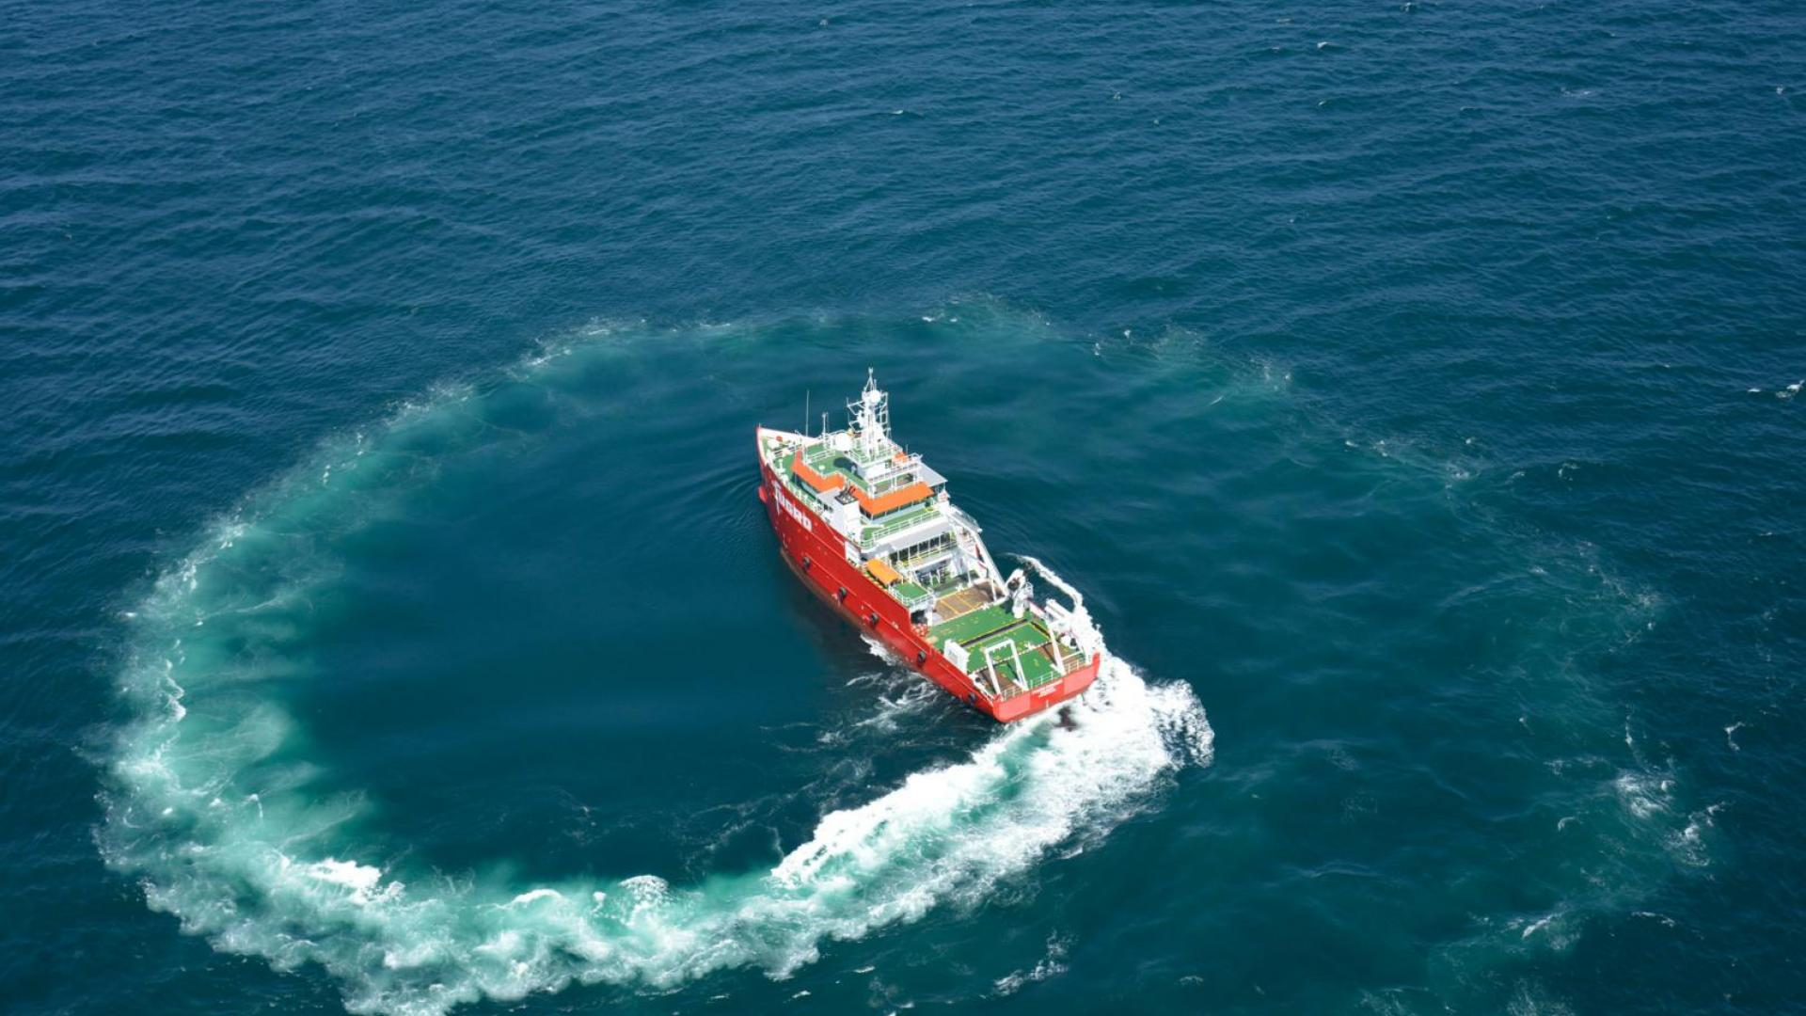

20240404_Matthis
20240404_Wieger
Thermal Stress-Aware Power Modulation for Solid Oxide Fuel Cell Systems through Model Predictive Control - Matthis de Lange
Ship based carbon capture systems – The LNG-Zero project
Wieger Peet
To mitigate polluting emissions in the maritime sector, Solid Oxide Fuel Cells (SOFC) are being explored as alternative power sources for vessels as they offer improved fuel conversion efficiency and reduced emissions. However, SOFCs encounter challenges related to slow power regulation, due to implicit constraints imposed by the need to limit thermal stress in the cells. Thermal stress can potentially damage the cell stack, thus efficient and safe control strategies are essential for the successful integration of SOFCs onboard a vessel. In previous research, these implicit constraints restrict the power modulation either by restricting the power reference or via a rate limit on the electrical current. In this research, we propose to address this explicitly by integrating thermal stress considerations, specifically spatial temperature gradients, into the control strategy using a Model Predictive Control (MPC) approach. This allows us to dynamically regulate the SOFC within the spatial temperature gradient constraints, enhancing the SOFC’s ability to track a time-varying power demand.
The importance of reducing the harmful emissions from vessel is clear. But in order to reach the goals set by the IMO we need to come up with new solutions. LNG-Zero is an ambitious research project that aims to develop technologies and strategies to drastically reduce the emissions from LNG powered vessels, making the shipping industry more sustainable. The main focus of the LNG-Zero project is on accelerating a novel technology for reducing the GHG emissions and NOx on LNG fuelled vessels. In order to reach the low levels of emissions set in this project, a comprehensive cleaning step of the exhaust gas has to be performed.
During my presentation I will tell more about the goals of the project, the technologies that are being used/developed and what we are doing to support the project.

Slide 7
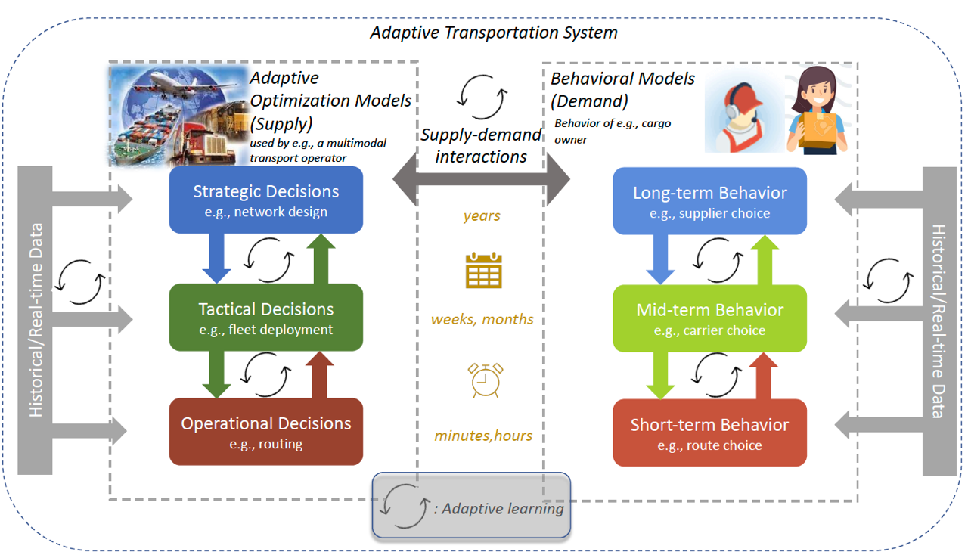
20240411_Bilge
Adaptive Transportation and Logistics through Operations Research, Behavioral Modeling and Machine Learning – Bilge Atasoy
Operations Research, Behavioral Modeling and Machine Learning need to work hand in hand to reach adaptive transport systems. The intersection between these methodologies enable to have (1) a predictive decision making towards robustness (2) a user-centric nature for better incorporation of preferences (3) an adaptive system that continuously evolve towards better decisions and better representation of user behavior. In this talk I will provide examples across different applications from last-mile deliveries to intermodal transport.

Slide 8
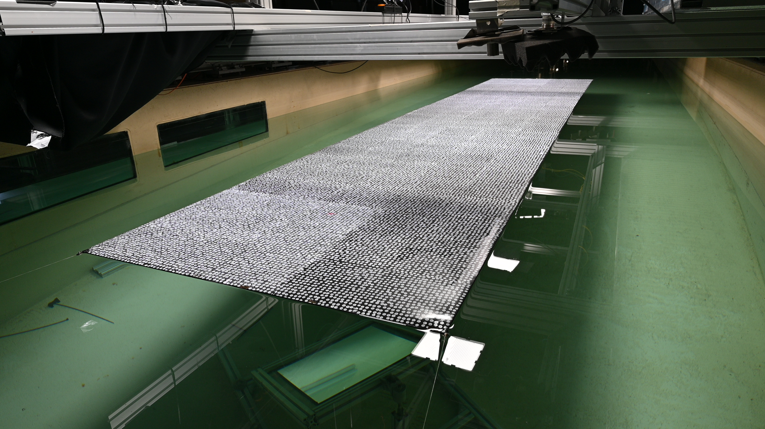
20240502_Jasper
20240502_Hanna
Picture
Dynamic modelling of internal combustion engines running on alternative fuels
Jasper Vollbrandt
Experimental Wave-Structure Interaction of membrane-type Floating Photovoltaics Hanna Pot
The global shipping industry is at a crucial juncture, facing an urgent need to reduce greenhouse gas emissions in the short to medium term to mitigate climate change.
A shift towards alternative fuels is imminent, necessitated by the limitations in current fuel cell and battery technology in terms of power density.
Currently, the most promising candidates are hydrogen, ammonia, and methanol.
However, compared to marine diesel engines, engines running on alternative fuels limit the dynamic performance to assure a stable combustion process and prevent knocking and misfire.
This research focusses on the complex dynamic interaction between the gas-path and the in-cylinder process of marine engines on alternative fuels.
With a combination of physical experiments and engine simulations, we try to understand what enables and limits dynamic performance.
During my presentation I will give some background information, talk about the challenges of combining physical and simulation experiments, and show first results.
Membrane-type support structures offer a promising avenue for reducing construction costs of offshore floating photovoltaic (PV) systems, potentially enhancing economic viability compared to traditional rigid supports. However, this type of structure is yet scarcely researched, such that hydrodynamics, wave-structure interactions and mooring loads are hard to quantify. To obtain a deeper understanding of the dynamic motion behaviour of these systems, our research focuses on the experimental quantification of mooring loads and the dynamic response of membrane structures under wave action. Wave tank experiments are conducted using a 5-meter-long neoprene model to simulate wave response. The model's deflections are captured using Digital Image Correlation, a stereovision technique that allows for precise full-field deformation analysis. Preliminary results of these experiments are presented.

Slide 9
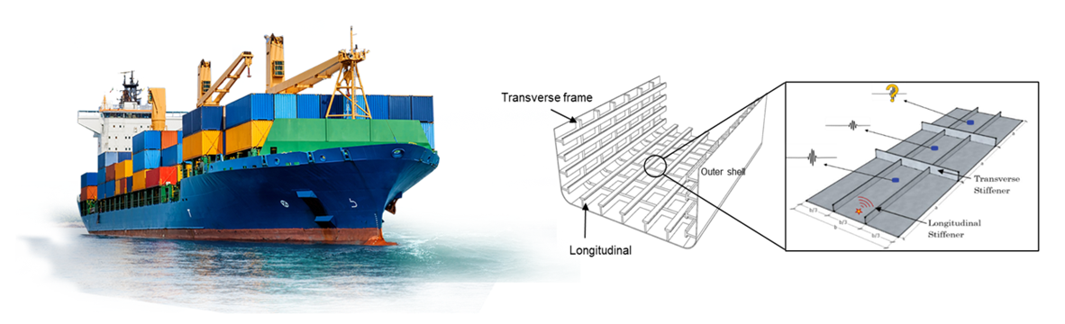
20240606_Cecilia
Acoustic Emission Sensing for Informed Maintenance of Ship Structures – Cecilia Saccone
Naval vessels are valuable national assets that are expensive to build and maintain. Predictive maintenance is crucial to enhance their efficiency and operability, and to extend their service life. Fatigue is regarded as one of the main degradation modes affecting the structural integrity of ship structures. Conventional non-destructive techniques to assess the structural integrity of ships consist of time-consuming, costly, and physically demanding procedures. This research deals with the development of an Acoustic Emission (AE) monitoring methodology to detect and characterise fatigue damage in ship structures under operational conditions.

